Slide 1
Autonomous Foosball Bot
“man v/s machine” in a game of foosball.

Slide 2
Overview and Motivation
An autonomous foosball bot provides a challenging and entertaining scenario of “man v/s machine” in a game of foosball. It provides an opportunity to the relatively experienced player to play against a formidable opponent without having to search for a human challenger. At present, there are no such machines available in mass production. So our team would like to develop a working prototype of such a device.

Slide 3
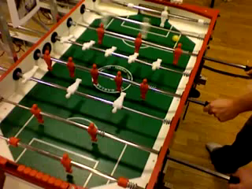
Our FINAL RESULT WOULD BE…

Slide 4
Theory of implementation
We plan to use an array of IR LEDs and sensors, to map the entire foosball table on a pair of coordinate axes. The position of the ball at any given time is located using this coordinate mapping. The nearest “player” then tries to kick the ball in the direction of the opponent’s goal. Once this functionality is implemented, we plan to use the concepts of machine learning to develop coordination between the different rows of “players”.

Slide 5
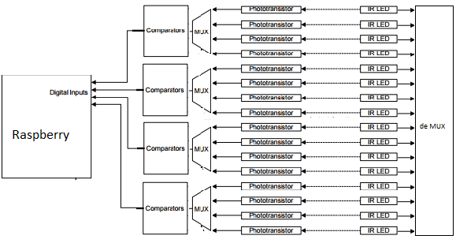
IR position finder circuit

